Slide 1
SINGE-USE PLASTICS POST-COVID WORLD

Slide 2
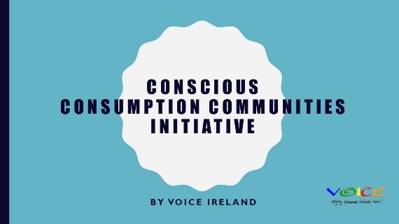
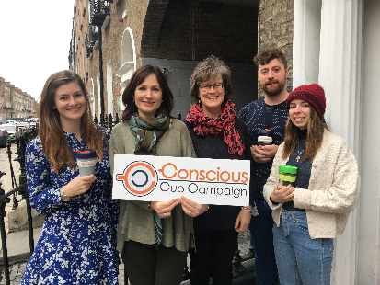
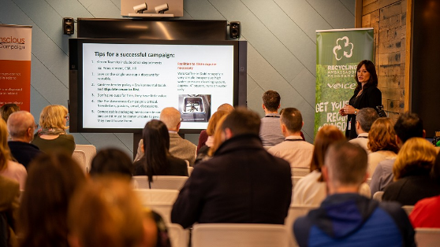
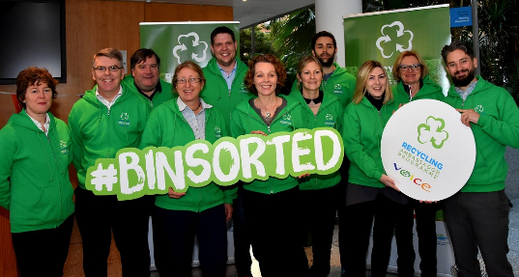
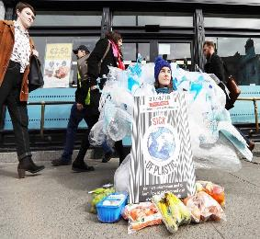
VOICE – working for a more sustainable future
Notes:
VOICE is a membership based NGO campaigning on issues around waste and sustainable consumption since 1997 (SDG 12 – sustainable consumption)
VOICE advocates for the government and the corporate sector to adopt environmentally responsible behaviours, and for the development of strong national policies on waste and water issues.
Projects over the years include the plastic bag tax, Feed the 5000, zero waste cashel, Conscious Cup and RAP
VOICE also works to campaign politicians and shape policy in Ireland and has campaigned on the Climate Change bill in 2010, the Waste reduction bill and the EU plastics ban in 2018
In 2018 we engaged with communities and businesses across the country on recycling

Slide 3
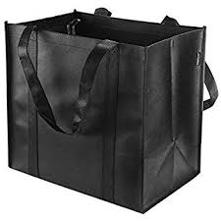
BAGS FOR LIFE

Slide 4
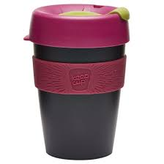
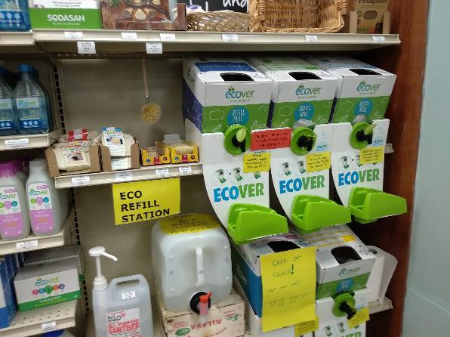
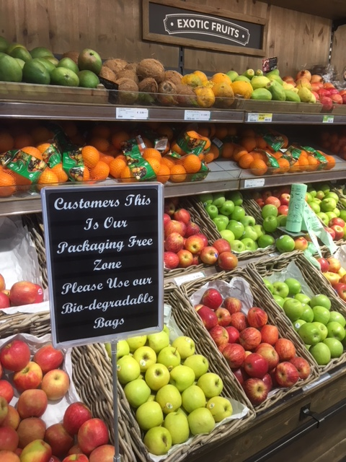
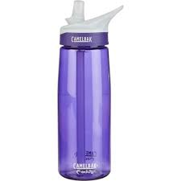

Slide 5
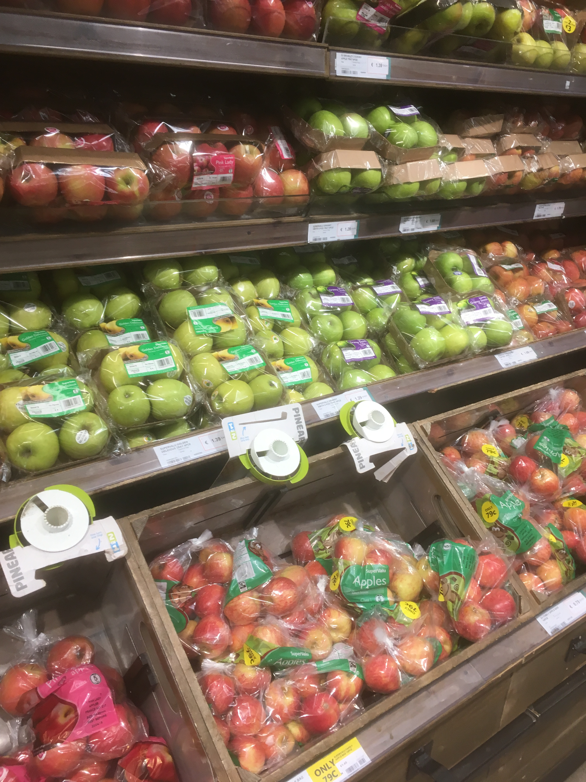
Covid19 Risks: WHICH IS SAFER? THIS?

Slide 6
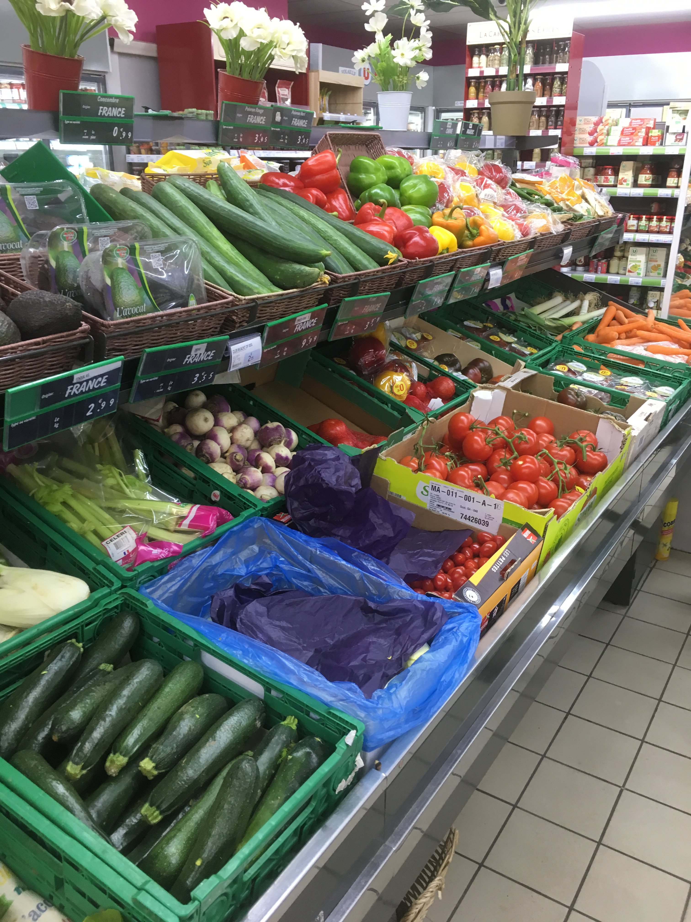
OR THIS?

Slide 7
This?

Slide 8
Or This?

Slide 9
Plastic Industry says….
“…single-use plastic products are the most sanitary choice when it comes to many applications, especially the consumption and transport of food, whether purchased at a restaurant or at a grocery store.”
Letter from the Plastics Industry Association to Secretary Alex Azar, Department of Health and Human Services, 18th March 2020

Slide 10
Scientists Say…
Covid19 can last on the surface of plastic and stainless steel for up to 72 hours
It lasts on cardboard up to 24 hours.
New England Journal of Medicine 17th March 2020

Slide 11
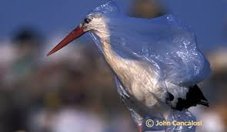
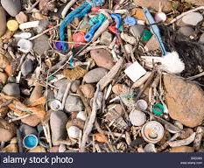
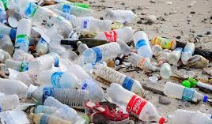
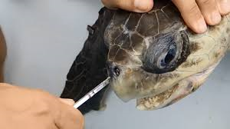

Slide 12
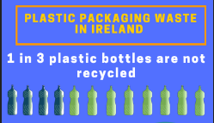
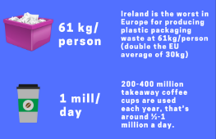
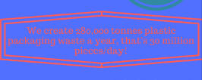

Slide 13
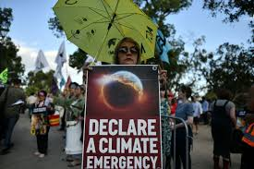
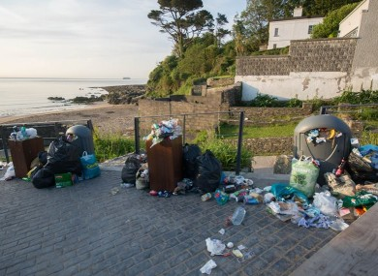

Slide 14
Consumption
Local Jobs
Sustainable Production & Consumption
Emissions/ pollution
Reuse & Repair & Sharing Economy
(Circular Economy)
Paradigm Shift

Slide 15
What Happens post-Covid19?
Single-Use Plastic Reduction by 30% by 2030
Recycling target of 55% of plastic packaging by 2030
Shorten Food supply market and reduce food waste by ½ by 2030
Local
Seasonal
Organic
Pivot:
Buy the Product….not the packaging
Make it mainstream

Slide 16
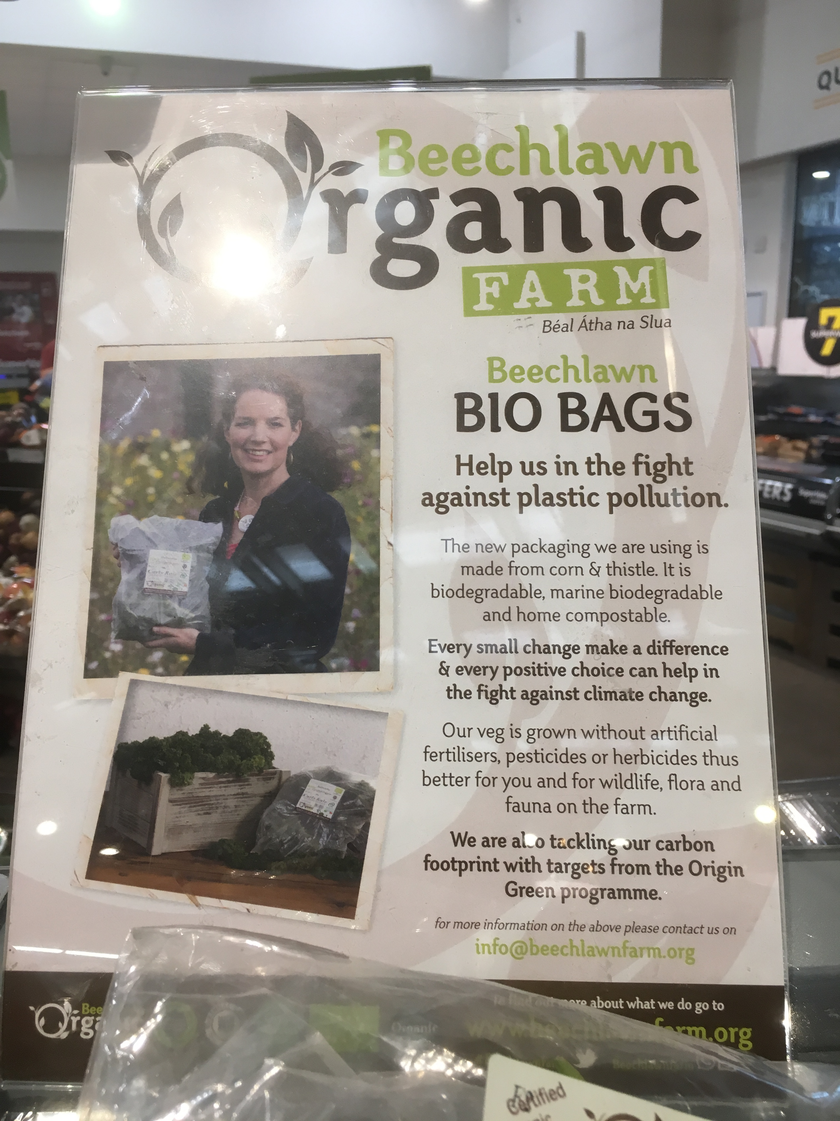
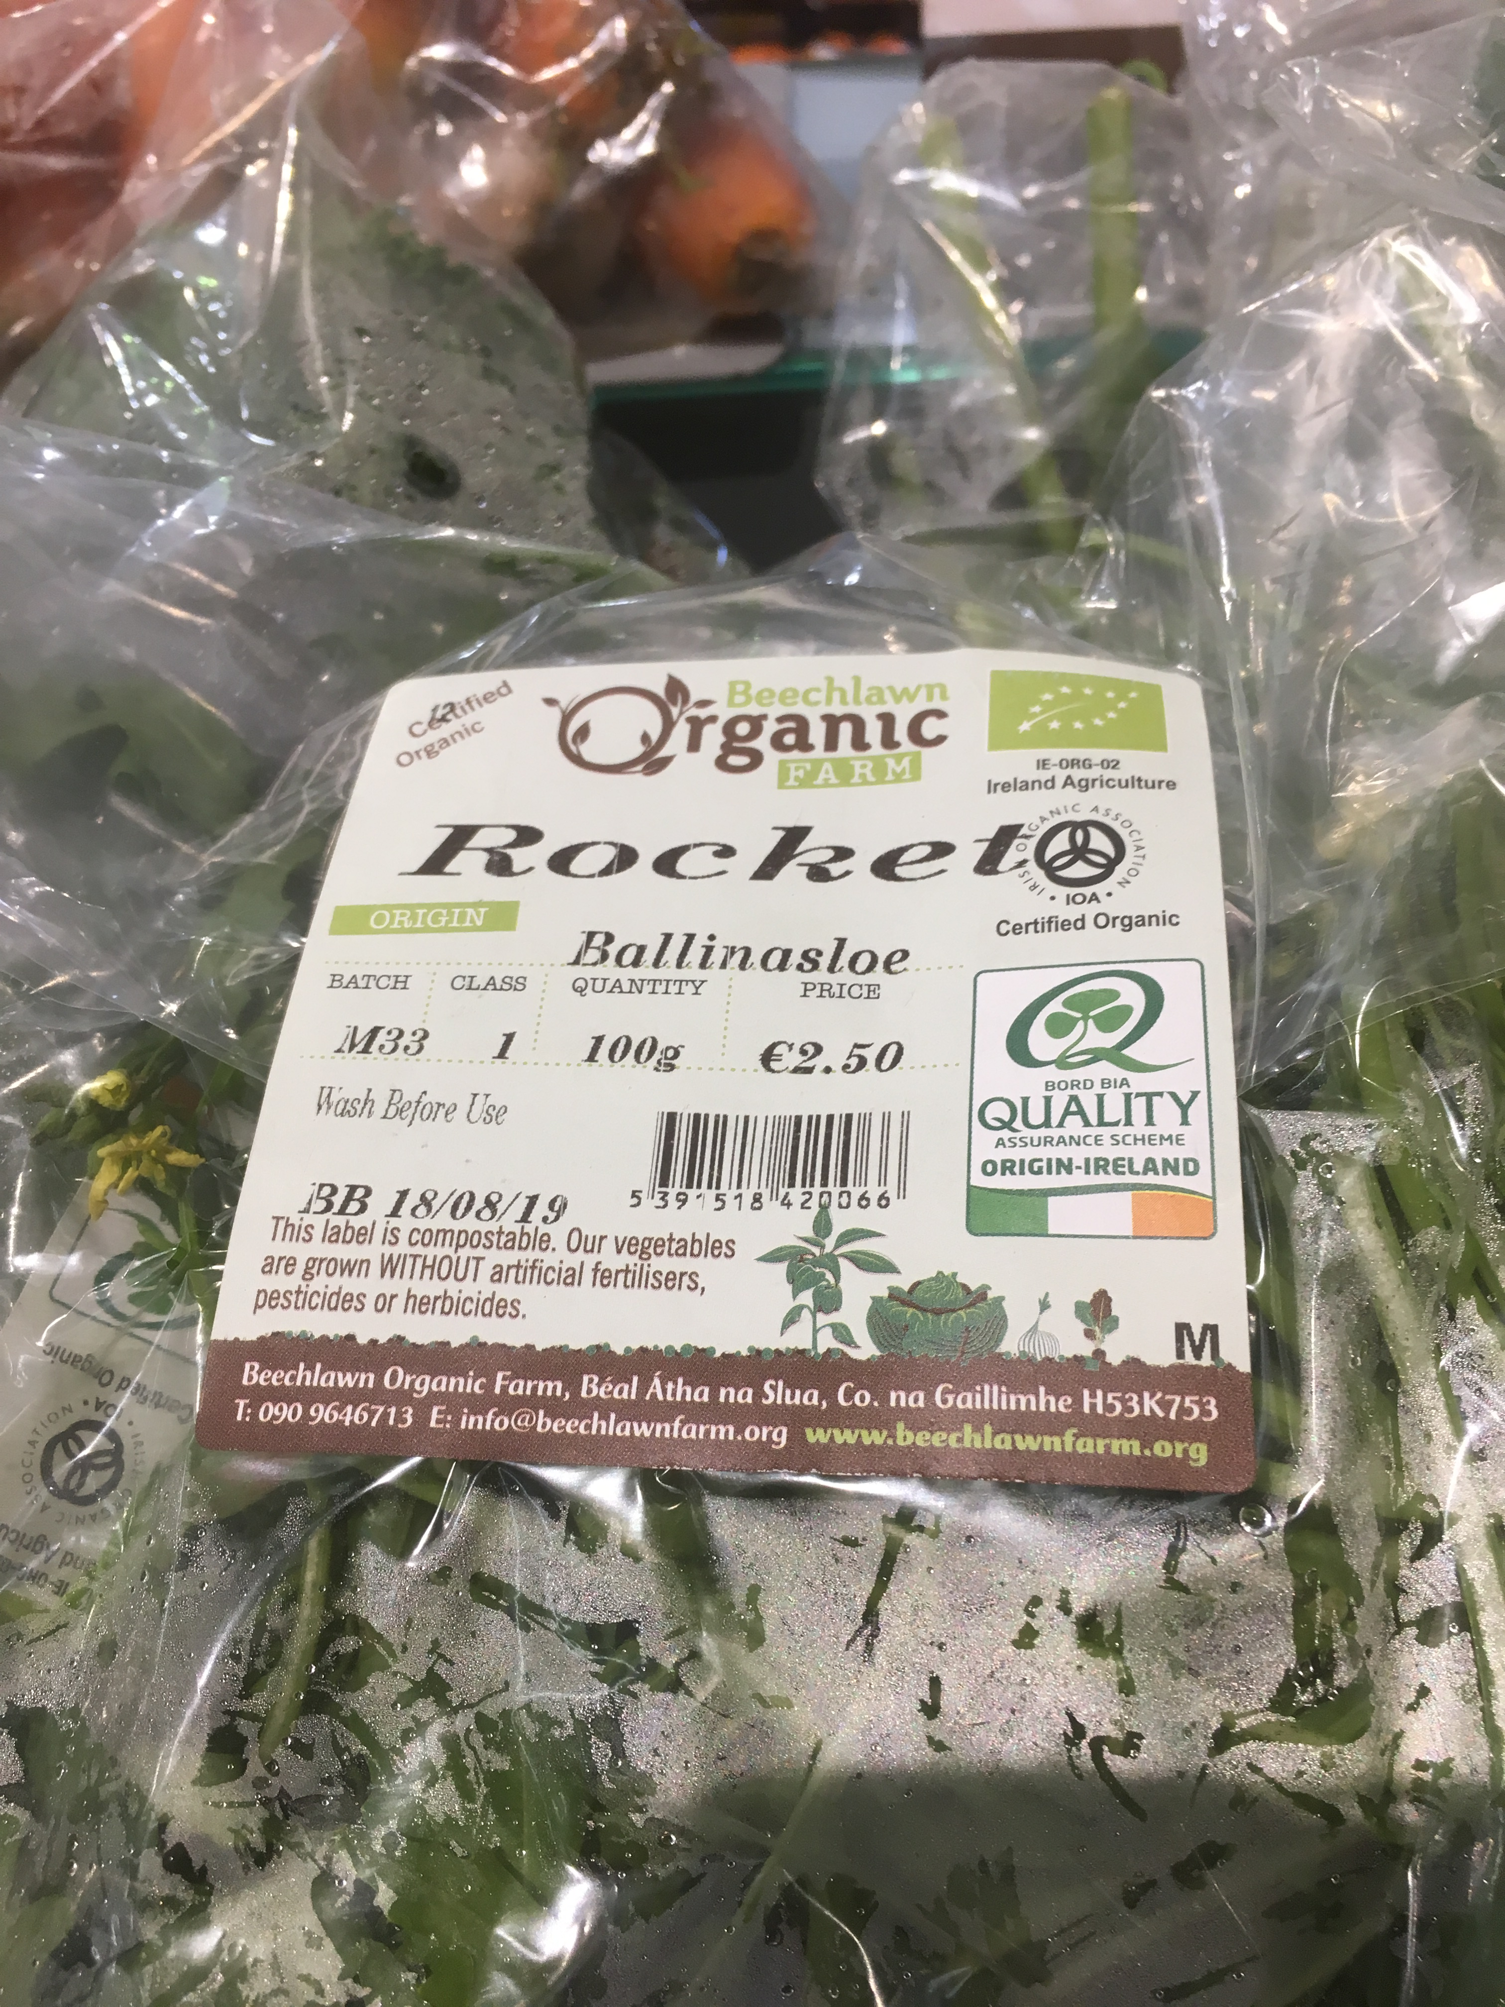
Are Compostables the Answer?

Slide 17
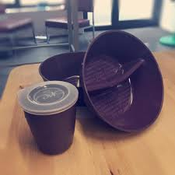
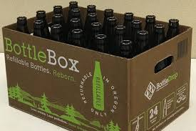
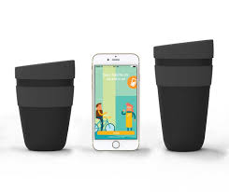
New Reuse Systems

Slide 18
Single Use Plastics are 10 minutes in use and 400 years in our environment
Let’s do our part!
For ourselves, our environment and our world!

Slide 19
Mindy O’Brien Coordinator mindy@voiceireland.org www.voiceireland.org
Please Join as a Member or Sign up to our Newsletter!

